Slide 1
Building for the Future: Policies to Increase Housing Production
The Council of State Governments, MLC Meeting
Sunday, August 30, 2026
Elizabeth Glidden, Deputy Executive Director, MHP

Slide 2
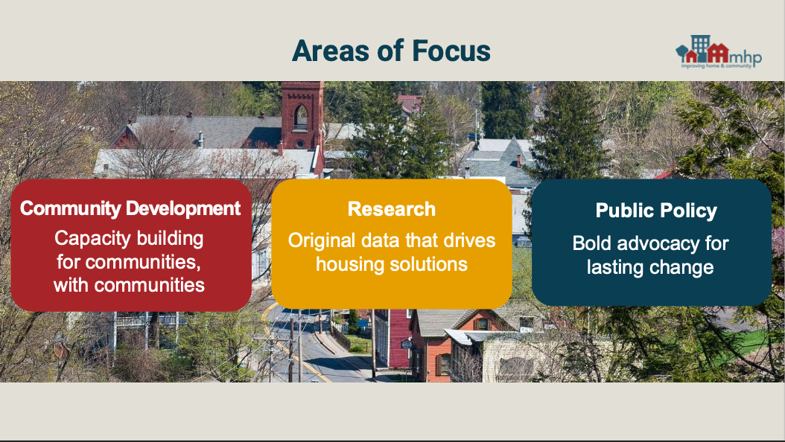

Slide 3
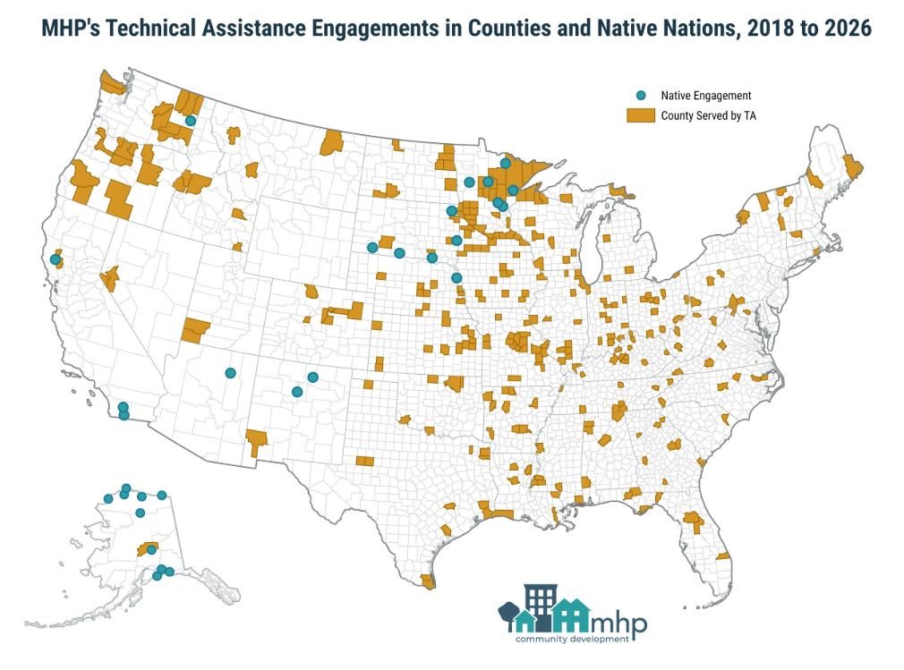
As a national technical assistance provider, MHP helps communities turn housing need to action

Slide 4

State Housing Solutions
Production-focused messaging/policy
Bipartisan support
Multiyear campaigns
Large coalitions, unusual partners
Lessons from peer states
Minnesota’s State Housing Tax Credit

Slide 5
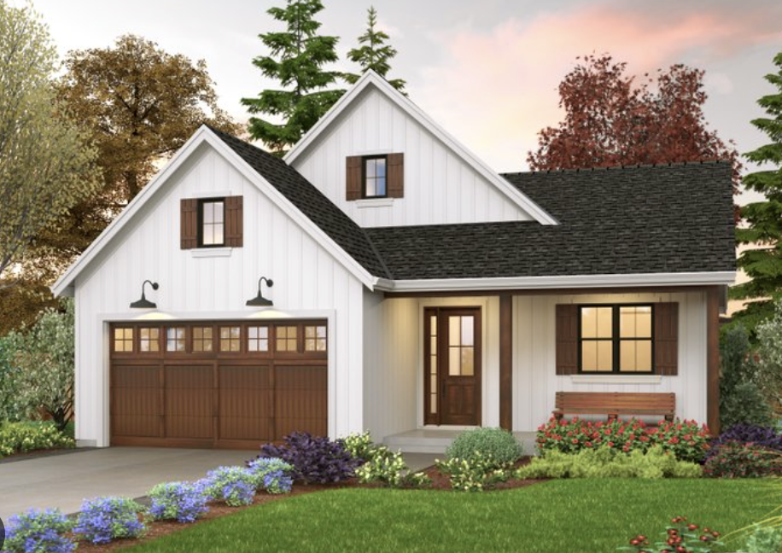
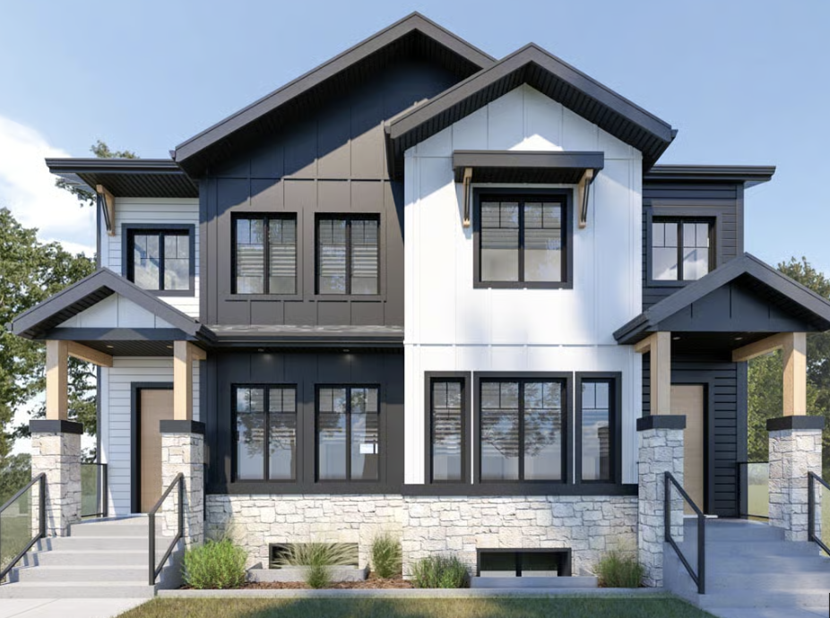
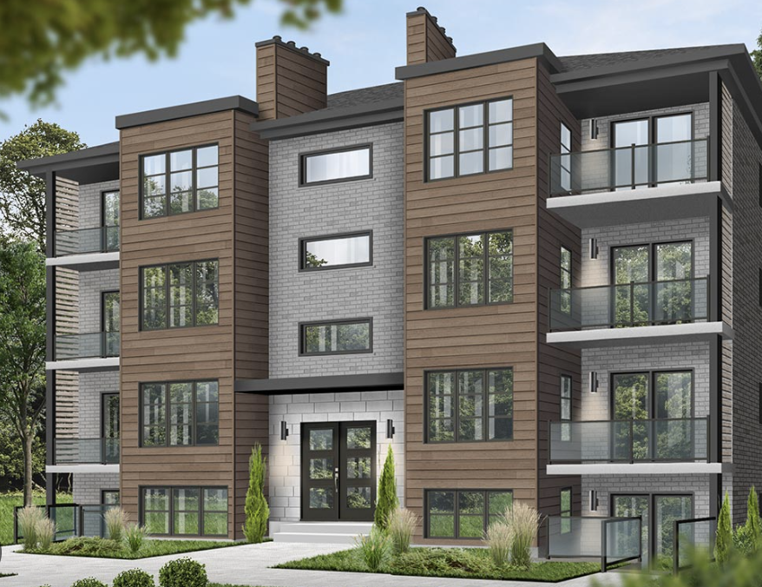

Clear Performance Standards and Range Of Housing Options To Build…
… Starter Homes In Growing Communities
… More Home Options In Existing Neighborhoods
… More Homes Near Jobs and Transit
Streamlined Approval For All Housing Meeting These Standards

Slide 6
Yes to Homes!
Strengths
Strong bipartisan lawmaker champions
Powerful narrative - controlling the message
Active, growing coalition
Opportunities
Continue to address “local control” concerns
Increase Leadership support (House/Senate)

Slide 7
Yes to Homes!
3 Bills in 2025 → 1 Bill in 2026
Interim last year: drafting and refining process of new bill language
1 Bill Concept Rollout Led by Bill Authors
Conversations with local elected officials, city groups, and fellow legislators
Notes:
Courtney

Slide 8
Base: All Cities | Base+: > 5k or 2.5k in Metro | Menu: # based on size
Removes aesthetic mandates​ | Administrative approval​ for multifamily that meets certain standards | Mixed housing in % of area zoned for single-family​
Prohibition on requiring HOAs as condition of permit | Mixed housing​: duplexes​, tri- quad-, townhomes​, in 33% SF | Multifamily in % of area zoned for commercial use
Accessory dwelling units permitted (minimum number) | Greenfield lot sizes and bulk controls: no larger than 1/8 of acre​, 1,500 square feet for a townhouse in greenfield or mixed housing | Parking minimums
 | Multifamily in commercial​ | Upzoning - increase FAR by 25%, 8 units in SF
 |  | Housing Trust Fund
 |  | Development subsidies
Notes:
Courtney

Slide 9
Yes to Homes! Winning the Public Opinion Debate
By the numbers
  6 OpEds
  Coalition members use social media highlight Starter Homes Ac
  Invite community members to take action
  6+ LTEs placed
Tone shift
  During 2026, see growing support from media and lawmakers
  House Speaker signals support in press
  City that placed moratorium on construction received negative media coverage and commentary

Slide 10


Slide 11
Minnesota’s State Housing Tax Credit
$9.9 million in state housing tax credits available annually for 6 years, starting in 2023 (sunsets in 2028)
Eligible taxpayers can contribute from $1000 to $2 million and receive a 85% state tax credit
Taxpayers can indicate if they are providing a Designated Contribution for a Qualified Project or contributing to the general pool

Slide 12
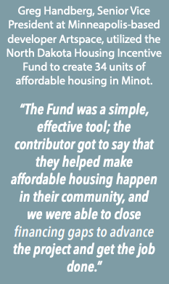





Minnesota’s State Housing Tax Credit

Slide 13
Minnesota’s State Housing Tax Credit
Multifamily projects
Single family projects
Eligible Projects
Gap financing Demolition
New Construction Construction
Acquisition Permanent financing
Rehabilitation
Eligible Activities
Income Limits
80% of AMI for rental housing projects
115% of AMI for homeownership projects

Slide 14

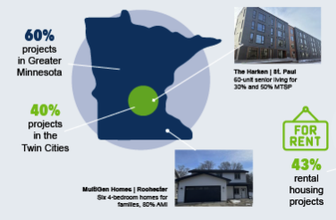

Minnesota’s State Housing Tax Credit

Slide 15

Minnesota’s State Housing Tax Credit
Key early policy questions
Amount of credit
Whether to target program (to geographies, housing types or income levels)
Next Steps in Minnesota
Remove the 2028 sunset / make permanent
Address geographic balance questions
Prepare to increase fund

Slide 16
Resources
Yes to Homes!
Campaign https://www.moreneighbors.org/yes-to-homes
2026 Bills: Starter Home Act: Eliminate barriers that drive up costs and streamline the process of single family development.
          HF3895
          SF4123
State Housing Tax Credit:
State’s Program Page: https://www.mnhousing.gov/home/rental-housing/housing-development-and-capital-programs/deferred-loans-and-grant-programs/state-housing-tax-credit-shtc
MHP website for promoting projects available for contributions: https://mhponline.org/housing-projects/
Notes:
Courtney

Slide 17

Connect with MHP
Elizabeth Glidden
Deputy Executive Director, MHP
elizabeth.glidden@mhponline.org
https://mhponline.org/
Explore MHP’s nationwide technical assistance programs for rural housing and community development: https://mhponline.org/community-development/rural-communities/
Notes:
Courtney

